Slide 1
English III
Argumentative Essay

Slide 2
General information
In class – 60 minutes
Handwritten, no technology
5 paragraphs (500-700 words)
Outline (now!)
First Draft – Week 14 Day 1
Peer Review – Week 14 Day 1
Second Draft – Week 14 Day 2
20 points

Slide 3
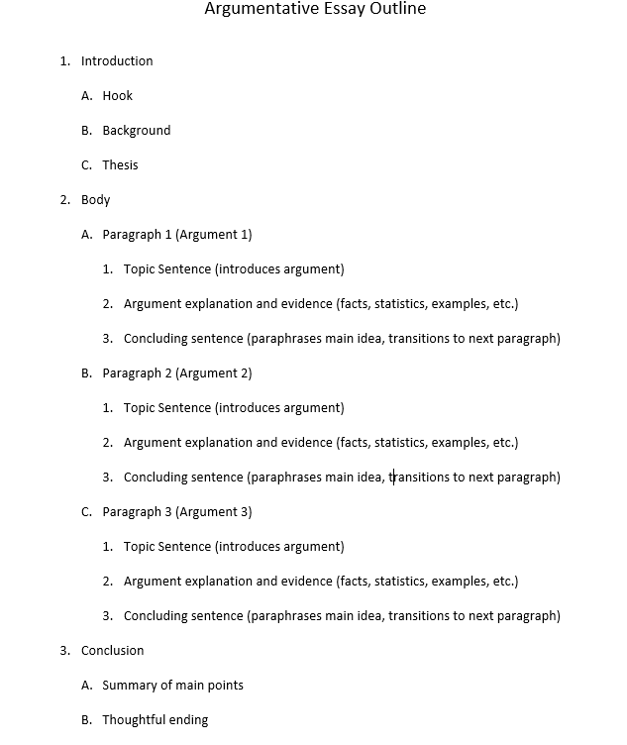


Slide 4
TOPICS
Plastic surgery should be banned
AI-generated art is not true art
AI technology and remote learning are superior to traditional classrooms
Aspiring entrepreneurs do not need to go to university
Money can’t buy happiness
Companies should implement 4-day work weeks
All students should study abroad
All university curriculums should include a second language

